Slide 1
SE-210
Software System Requirements
I. Introduction
Dr. Abdul Aziz
Department of Software Engineering
School of Computing
NUCES KHI Campus

Slide 2

Week 2 Class 1
RE-1 <number>

Slide 3
Course Objectives
Introduces process, methods and tools related to the software requirements engineering area.
Topics:
  Requirements elicitation
  Requirements analysis
  Requirements specification
  Requirements validation
  Requirements management
  Case studies
  Software engineering tools, such as RequisitePro, Rational Rose and Visio.
RE-1 <number>

Slide 4
Course Work
Homework assignments
  There will be at least two assignments
Midterm
  Two midterms
Final exam
Group project
  A software requirements specification
  Team of at least three
RE-1 <number>

Slide 5
Grading (Tentative)
Quiz 08%
Assignment 08%
Midterm 24%
Final exam 50%
Group project 10%
RE-1 <number>

Slide 6
Textbook
Gerald Kotonya and Ian Sommerville, Requirements Engineering: Processes and Techniques, John Wiley & Sons.
Geri Schneider and Jason Winters, Applying Use Cases: A Practical Guide, Second Edition, Addison-Wesley.
RE-1 <number>

Slide 7
Chapter 1 Overview
To introduce the notion of system requirements and the requirements engineering process.
To explain how requirements engineering fits into a broader system engineering process
To explain the importance of the requirements document
RE-1 <number>

Slide 8
System requirements
The requirements define the services that the system should provide and they set out constraints on the system’s operations
Define what the system is required to do and the constraints under which it is required to operate
Examples for a library system
  The system shall maintain records of all library materials including books, serials, newspapers and magazines, video and audio tapes, reports, collections of transparencies, computer disks and CD-ROMs.
  The system shall allow users to search for an item by title, author, or by ISBN.
  The system’s user interface shall be implemented using a World-Wide-Web browser.
  The system shall support at least 20 transactions per second.
  The system facilities which are available to public users shall be demonstrable in 10 minutes or less.

Slide 9
Types of requirements
Very general requirements which set out in broad terms what the system should do.
Functional requirements which define part of the system’s functionality.
Implementation requirements which state how the system must be implemented.
Performance requirements which specify a minimum acceptable performance for the system.
Usability requirements which specify the maximum acceptable time to demonstrate the use of the system.
RE-1 <number>

Slide 10
Requirements problems
The requirements don’t reflect the real needs of the customer for the system.
Requirements are inconsistent and/or incomplete.
It is expensive to make changes to requirements after they have been agreed.
There are misunderstandings between customers, those developing the system requirements and software engineers developing or maintaining the system.
RE-1 <number>

Slide 11
Example
The system shall Allow user to search an item by title, author or ISBN
The problems of writing Req. are universal and there will never be a complete solution to these problems.
RE-1 <number>

Slide 12
Week 2 Class 2
RE-1 <number>

Slide 13
FAQS about requirements
What are requirements?
  A statement of a system service or constraint
What is requirements engineering?
  The processes involved in developing system requirements
How much does requirements engineering cost?
  About 15% of system development costs
What is a requirements engineering process?
  The structured set of activities involved in developing system requirements
RE-1 <number>

Slide 14
FAQs contd.
What happens when the requirements are wrong?
  Systems are late, unreliable and don’t meet customers needs
Is there an ideal requirements engineering process?
  No - processes must be tailored to organisational needs
What is a requirements document?
  The formal statement of the system requirements
What are system stakeholders?
  Anyone affected in some way by the system
RE-1 <number>

Slide 15
FAQs contd.
What is the relationship between requirements and design?
  Requirements and design are interleaved. They should, ideally, be separate processes but in practice this is impossible
What is requirements management?
  The processes involved in managing changes to requirements
RE-1 <number>

Slide 16
What is RE?
It covers the following activities:
  Discovering
  Documenting
  Maintaining
  Set of Req. for a CBIS.
RE-1 <number>

Slide 17
How much it cost?
According to surveys
  10 – 15% of the total development cost.
RE-1 <number>

Slide 18
Systems engineering
There is a close relationship between software and more general system requirements
Computer-based systems fall into two broad categories:
  User-configured systems where a purchaser puts together a system from existing software products
  Custom systems where a customer produces a set of requirements for hardware/software system and a contractor develops and delivers that system
RE-1 <number>

Slide 19
Classes of custom systems
Information systems
  Primarily concerned with processing information which is held in some database.
Embedded systems
  Systems where software is used as a controller in some broader hardware system
Command and control systems
  Essentially, a combination of information systems and embedded systems where special purpose computers provide information which is collected and stored and used to make decisions
RE-1 <number>

Slide 20
Emergent properties
Emergent properties are properties of the system as a whole and only emerge once all of its individual sub-systems have been integrated
Examples of emergent properties
  Reliability
  Maintainability
  Performance
  Usability
  Security
  Safety
RE-1 <number>

Slide 21
Week 2 Class 3
RE-1 <number>

Slide 22
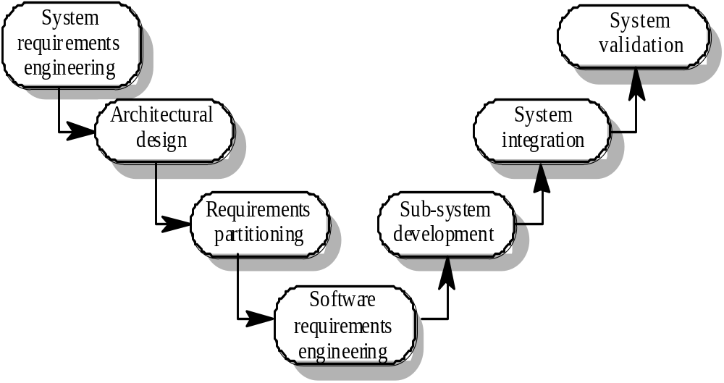
The systems engineering process
RE-1 <number>

Slide 23
System engineering activities
System requirements engineering
  The requirements for the system as a whole are established and written to be understandable to all stakeholders
Architectural design
  The system is decomposed into sub-systems
Requirements partitioning
  Requirements are allocated to these sub-systems
Software requirements engineering
  More detailed system requirements are derived for the system software
RE-1 <number>

Slide 24
System engineering activities
Sub-system development
  The hardware and software sub-systems are designed and implemented in parallel.
System integration
  The hardware and software sub-systems are put together to make up the system.
System validation
  The system is validated against its requirements.
RE-1 <number>

Slide 25
Requirements document
The requirements document is a formal document used to communicate the requirements to customers, engineers and managers.
The requirements document describes:
  The services and functions which the system should provide
  The constraints under which the system must operate
  Overall properties of the system i.e.. constraints on the system’s emergent properties
  Definitions of other systems which the system must integrate with.
  Info. about the application domain (How to carry out specific task/computation).
  Constraints on the process.
RE-1 <number>

Slide 26
Users of requirements documents
System customers
  specify the requirements and read them to check they meet their needs
Project managers
  Use the requirements document to plan a bid for system and to plan the system development process
System engineers
  Use the requirements to understand the system being developed
System test engineers
  Use the requirements to develop validation tests for the system
System maintenance engineers
  Use the requirements to help understand the system
RE-1 <number>

Slide 27
Requirements document structure
IEEE/ANSI 830-1993 standard proposes a structure for software requirements documents
1. Introduction
  1.1 Purpose of requirements document
  1.2 Scope of the product
  1.3 Definitions, acronyms and abbreviations
  1.4 References
  1.5 Overview of the remainder of the document
RE-1 <number>

Slide 28
Requirements document structure
2. General description
  2.1 Product perspective
  2.2 Product functions
  2.3 User characteristics
  2.4 General constraints
  2.5 Assumptions and dependencies
3. Specific requirements
  Covering functional, non-functional and interface requirements.
4. Appendices
5. Index
RE-1 <number>

Slide 29
Adapting the standard
The IEEE standard is a generic standard which is intended apply to a wide range of requirements documents.
In general, not all parts of the standard are required for all requirements documents
Each organisation should adapt the standard depending on the type of systems it develops
RE-1 <number>

Slide 30
Adapting the standard (cont…)
The following appendices may be included where appropriate:
  Hardware interface specification
  Software components which must be reused in the system implementation
  Data structure specification
  Data-flow models of the software system
  Detailed object models of the software system
Index
RE-1 <number>

Slide 31
Writing essentials
Requirements are read more often than they are written. You should invest time to write readable and understandable requirements
Do not assume that all readers of the requirements have the same background and use the same terminology as you
Allow time for review, revision and re-drafting of the requirements document
RE-1 <number>

Slide 32
Writing guidelines
Define standard templates for describing requirements
Use language simply consistently and concisely
Use diagrams appropriately
Supplement natural language with other description of requirements
Specify requirements quantitatively
RE-1 <number>

